Slide 1
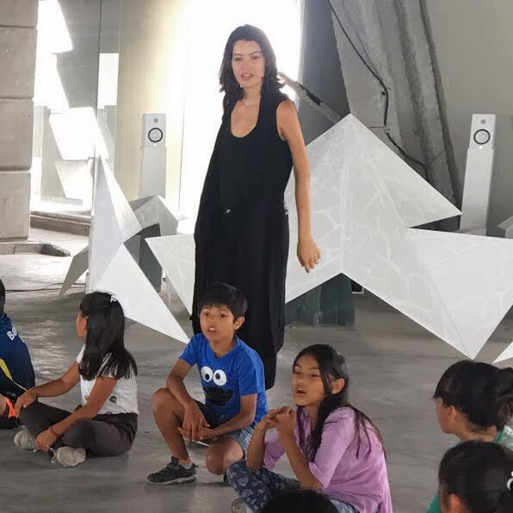
LUZ C PRO
Luz C. Pro is the founder and director of Arte Pro.
After more than ten years of entrepreneurship and six of them in social impact, Luz C. Pro creates unique platforms to connect multidisciplinary talent for social good.
She has worked in many European capitals, is fluent in five languages, and has studied in Potsdam, Germany.
She has dedicated nearly two decades working together with artists, and in 2014, she founded Arte Pro, an arts based organization that shows strong scientific evidence of having the largest positive impact on children's mental and emotional health.
Most notably, Pro was the first Mexican panelist at the 2017 symposium of the AMADE, directed by Princess Caroline of Monaco, where she talked about her work with children born in prison. In 2018, Arte Pro and its methodology were acknowledged by the Y2Y, World Bank Group. In 2019, she held a panel at the International Assembly of Educators without Borders on Art and Education as Social Intervention.

Slide 2
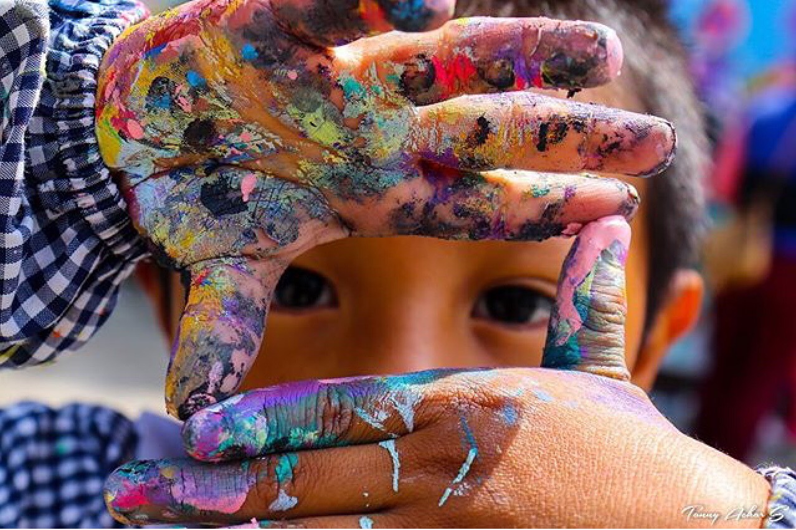
ART EMPOWERS
artepro.mx arte@artepro.mx Instagram @ArtePro PayPal donate@artepro.mx

Slide 3
WHAT IS ARTE PRO

Slide 4
ARTE PRO
We are a nonprofit organization united by our passion to make a difference. We vow to help and create change by making a better living condition for children in vulnerable situation through a collaboration between artists and mental health professionals.

Slide 5
ART
SOCIETY EMPOWERMENT

Slide 6
PROGRAMS IN MEXICO
SINCE 2014

Slide 7
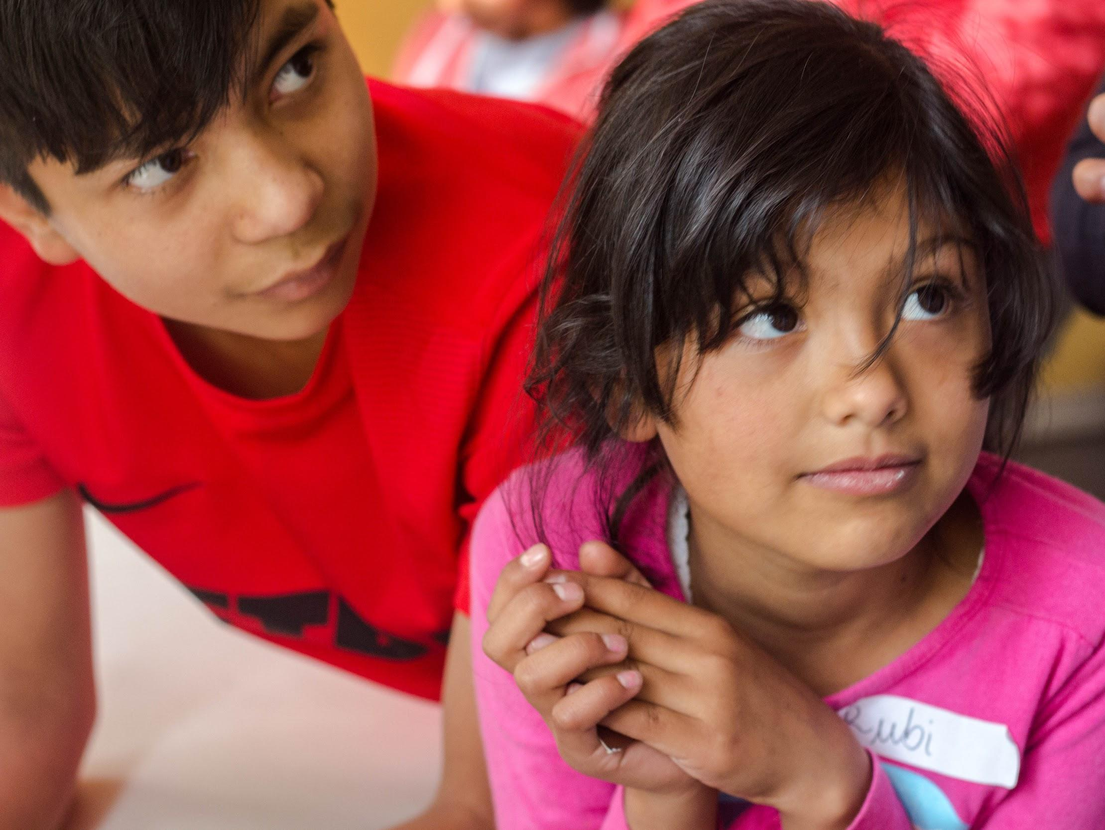
VULNERABLE CHILDREN AND YOUTH
SINCE 2014
ABUSE
EXTREME POVERTY
CHILD LABOR
LOWER OR NO SCHOOLING

Slide 8
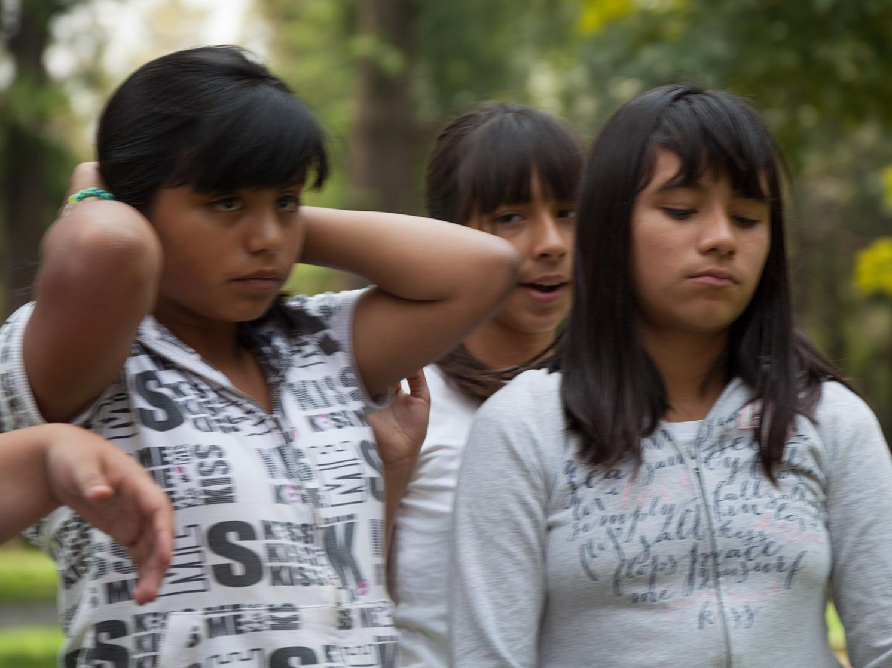
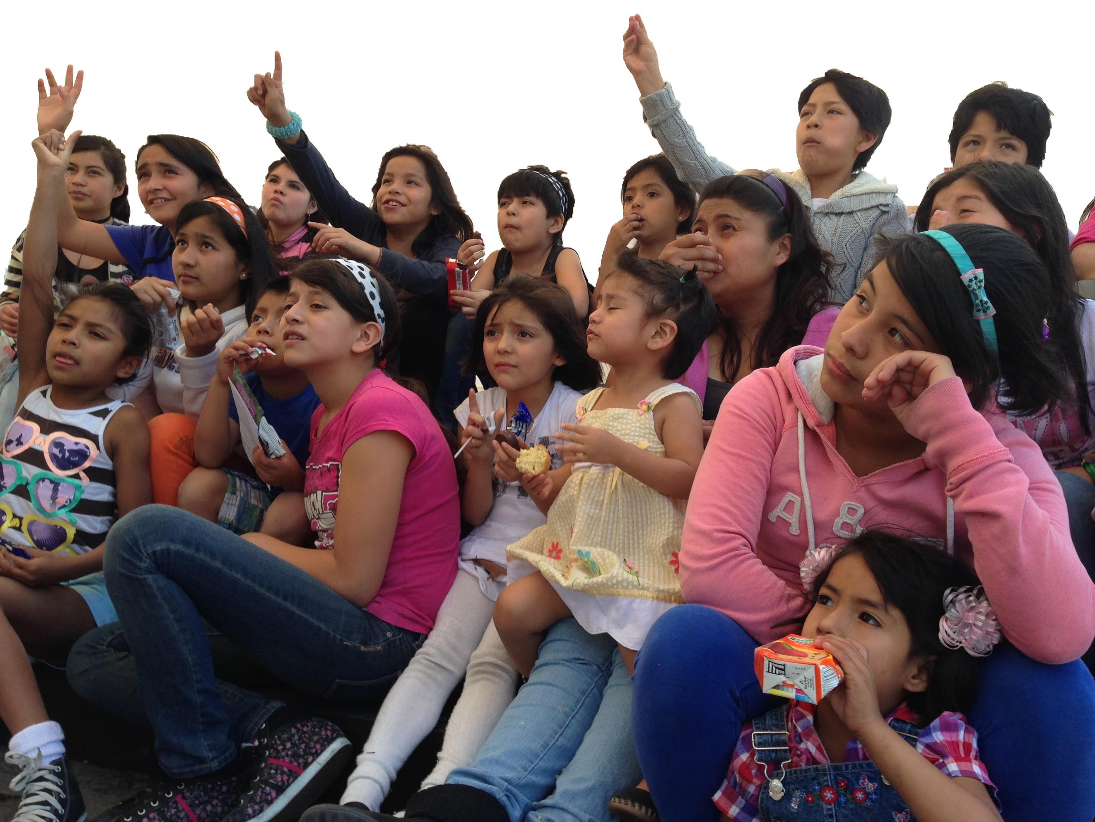
YOUNG WOMEN
SEXUAL ABUSE VICTIMS
SINCE 2014
GENDER VIOLENCE
PROSTITUTION
HUMAN TRAFFICKING
EARLY / UNWANTED PREGNANCIES

Slide 9
CHILDREN BORN IN PRISON
SINCE 2015
EARLY CHILDHOOD IN RECLUSION
VIOLENCE
SUBSTANCE ABUSE
NO BEDS
NO FOOD
OVERPOPULATION
*Reality inside prison violates the Standard Minimum Rules for the Treatment of Prisoners according to the UN
Human Rights Watch / Prison Conditions Mexico World Prison Brief / Mexico National System for Integral Family Development – DIF National Institute of Statistics and Geography – INEGI

Slide 10
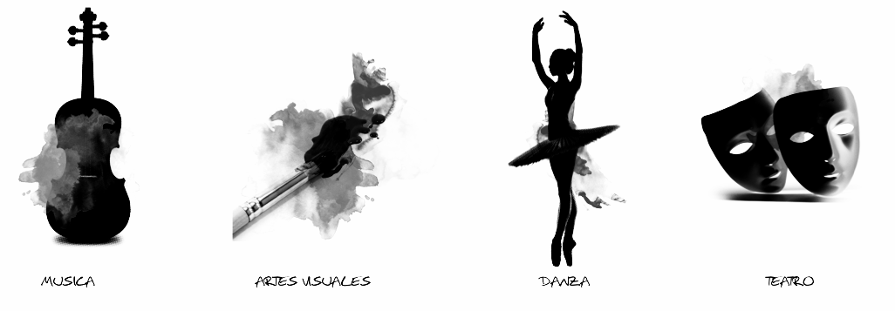
ART AS A VEHICLE FOR POSITIVE CHANGE
• MUSIC • ART • DANCE • THEATRE • MOVEMENT • CREATIVITY • COMMUNICATION • CONNECTION • EMOTION •

Slide 11
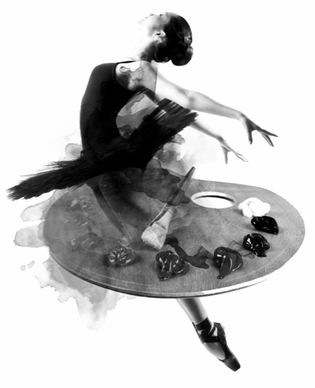
WORKSHOPS
MINUTE BY MINUTE
15m MINDFULNESS EXERCISE TO START
45m INTRODUCTION TO WORKSHOP (EXHIBITION OR PRESENTATION)
60m CREATIVE ACTIVITY
15m MINDFULNESS EXERCISE TO CLOSE
30m LUNCH

Slide 12
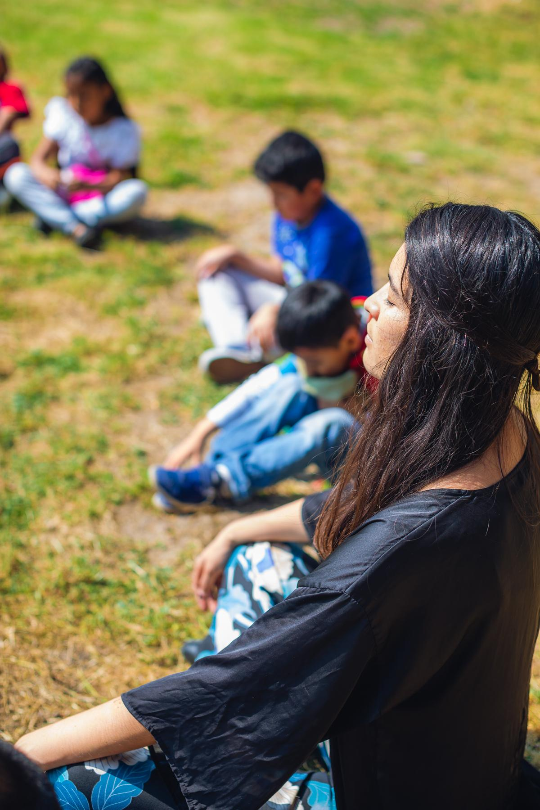
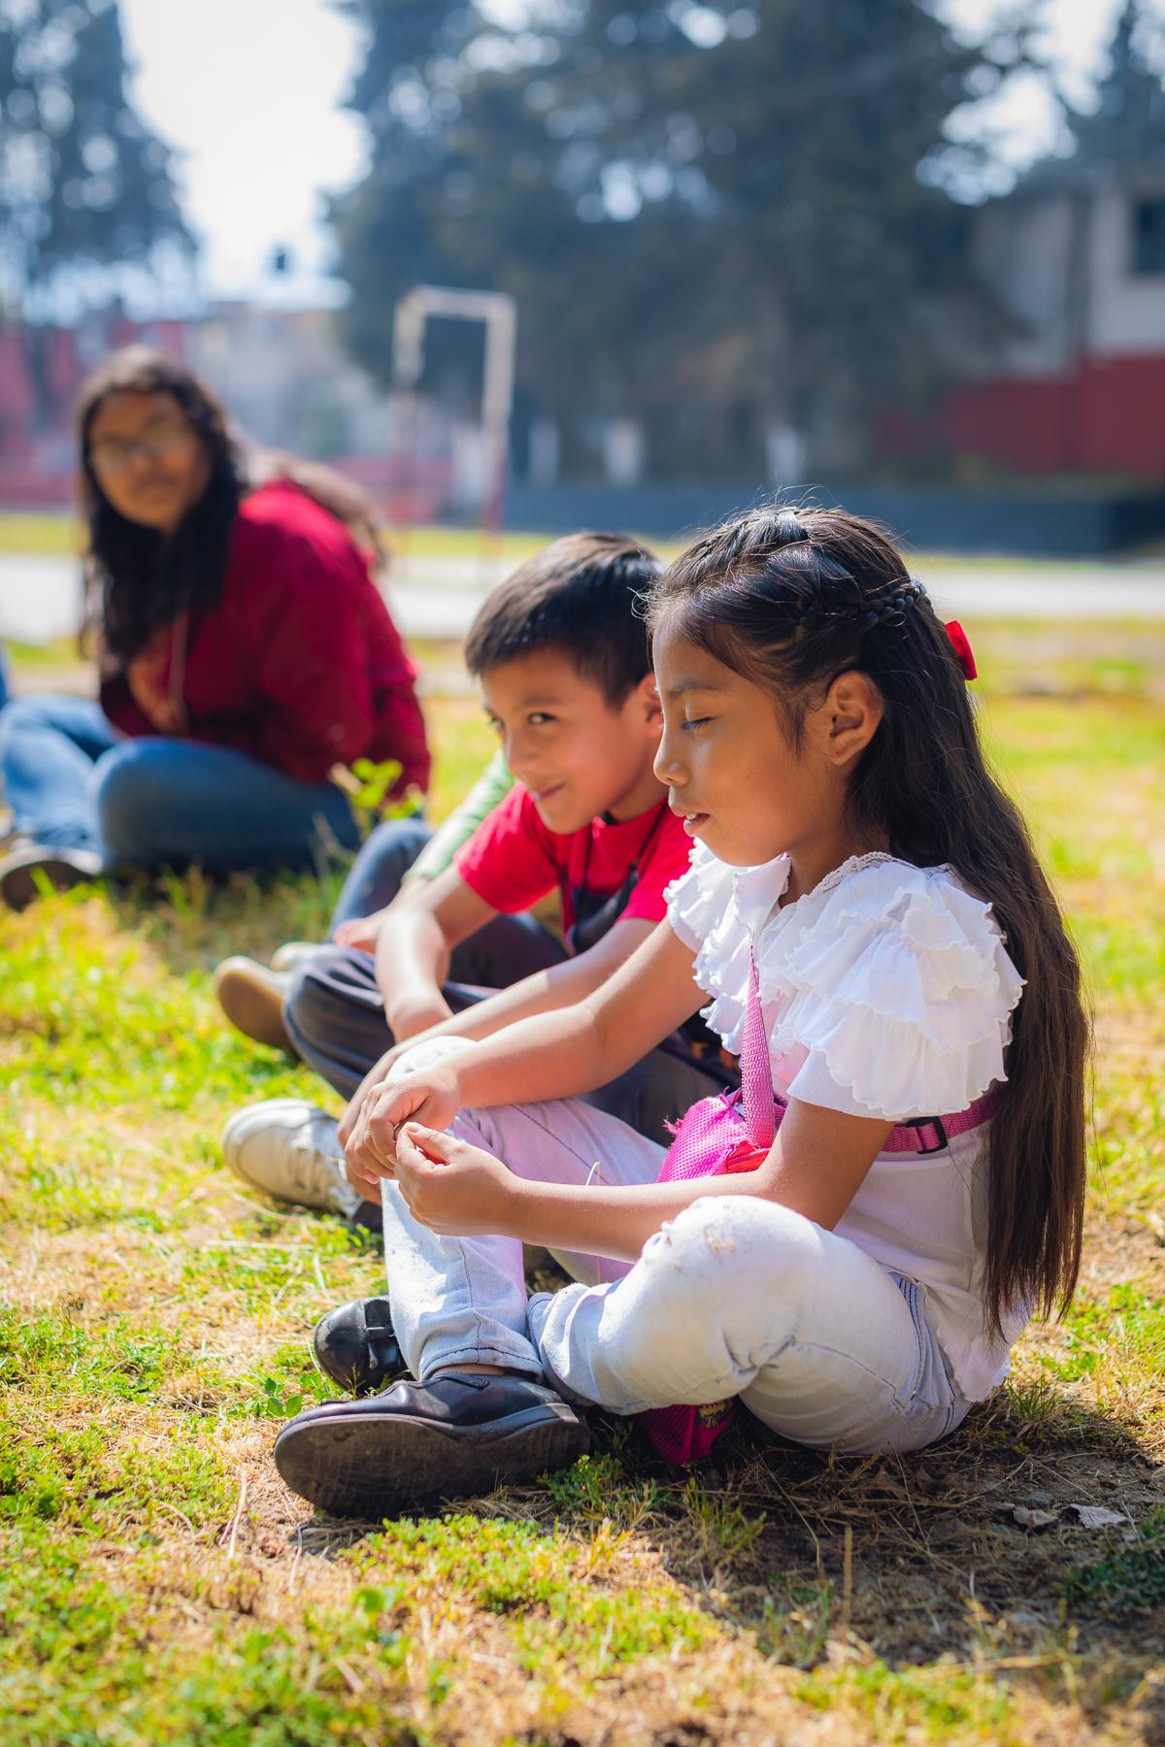
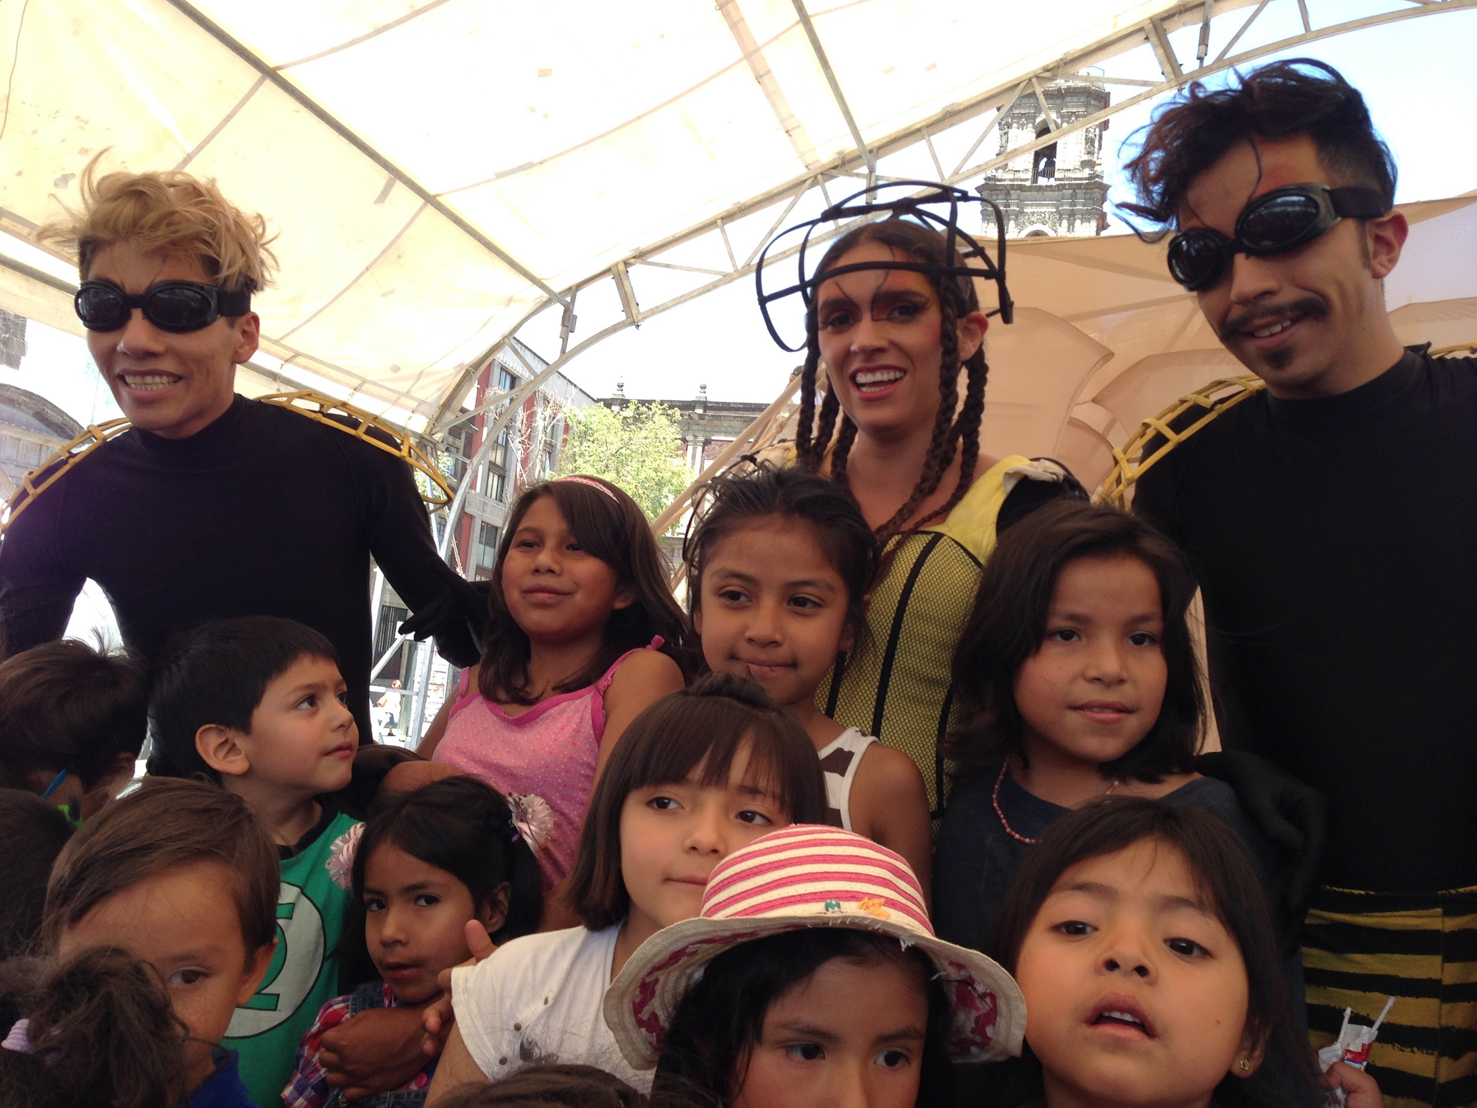
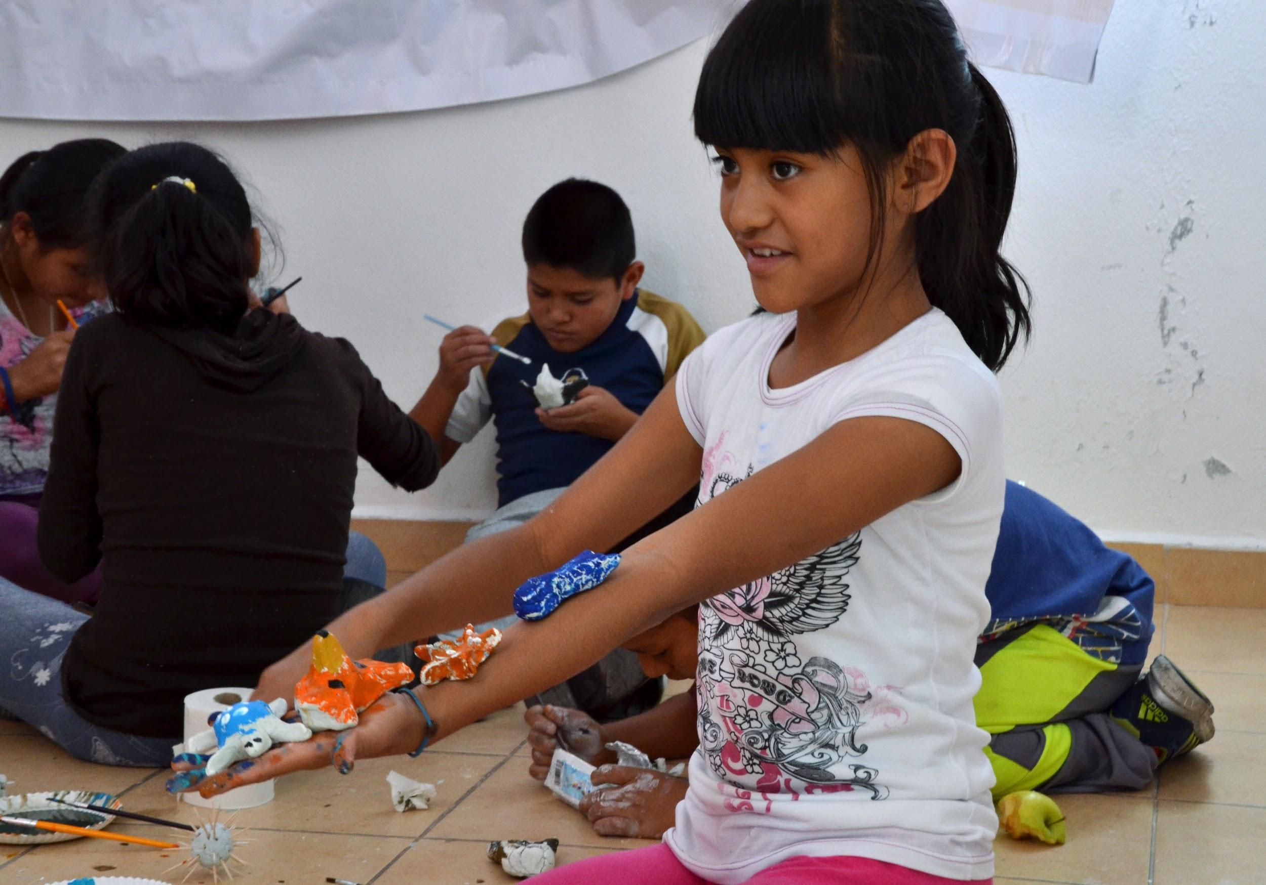
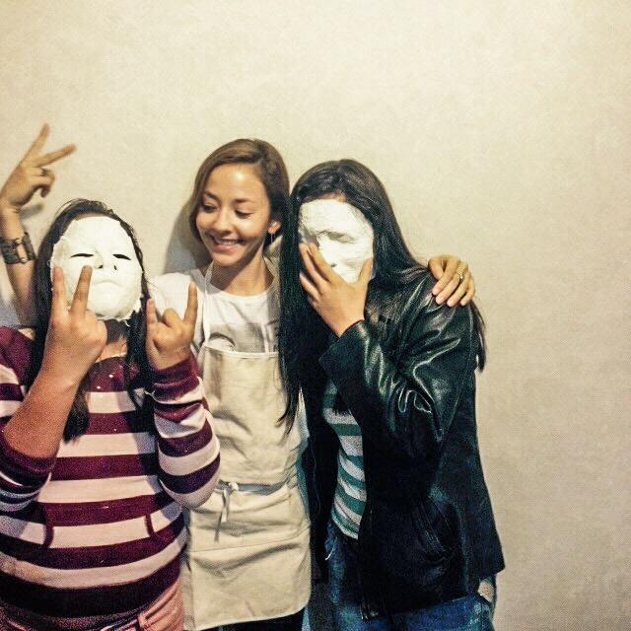
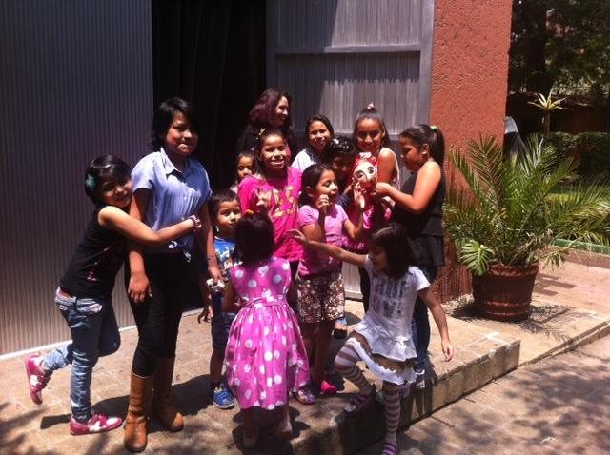
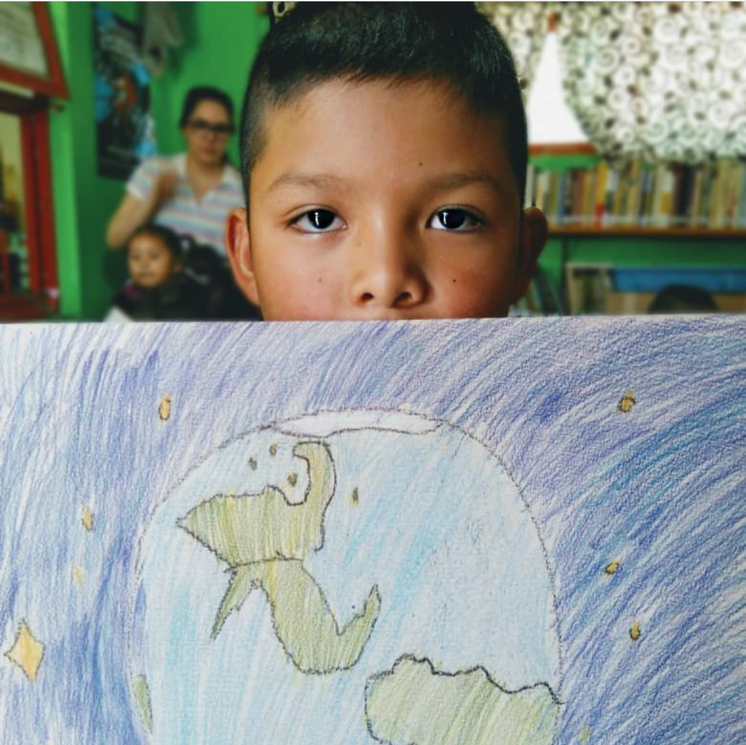
15m MINDFULNESS EXERCISE TO START AND FINISH THE SESSION

Slide 13
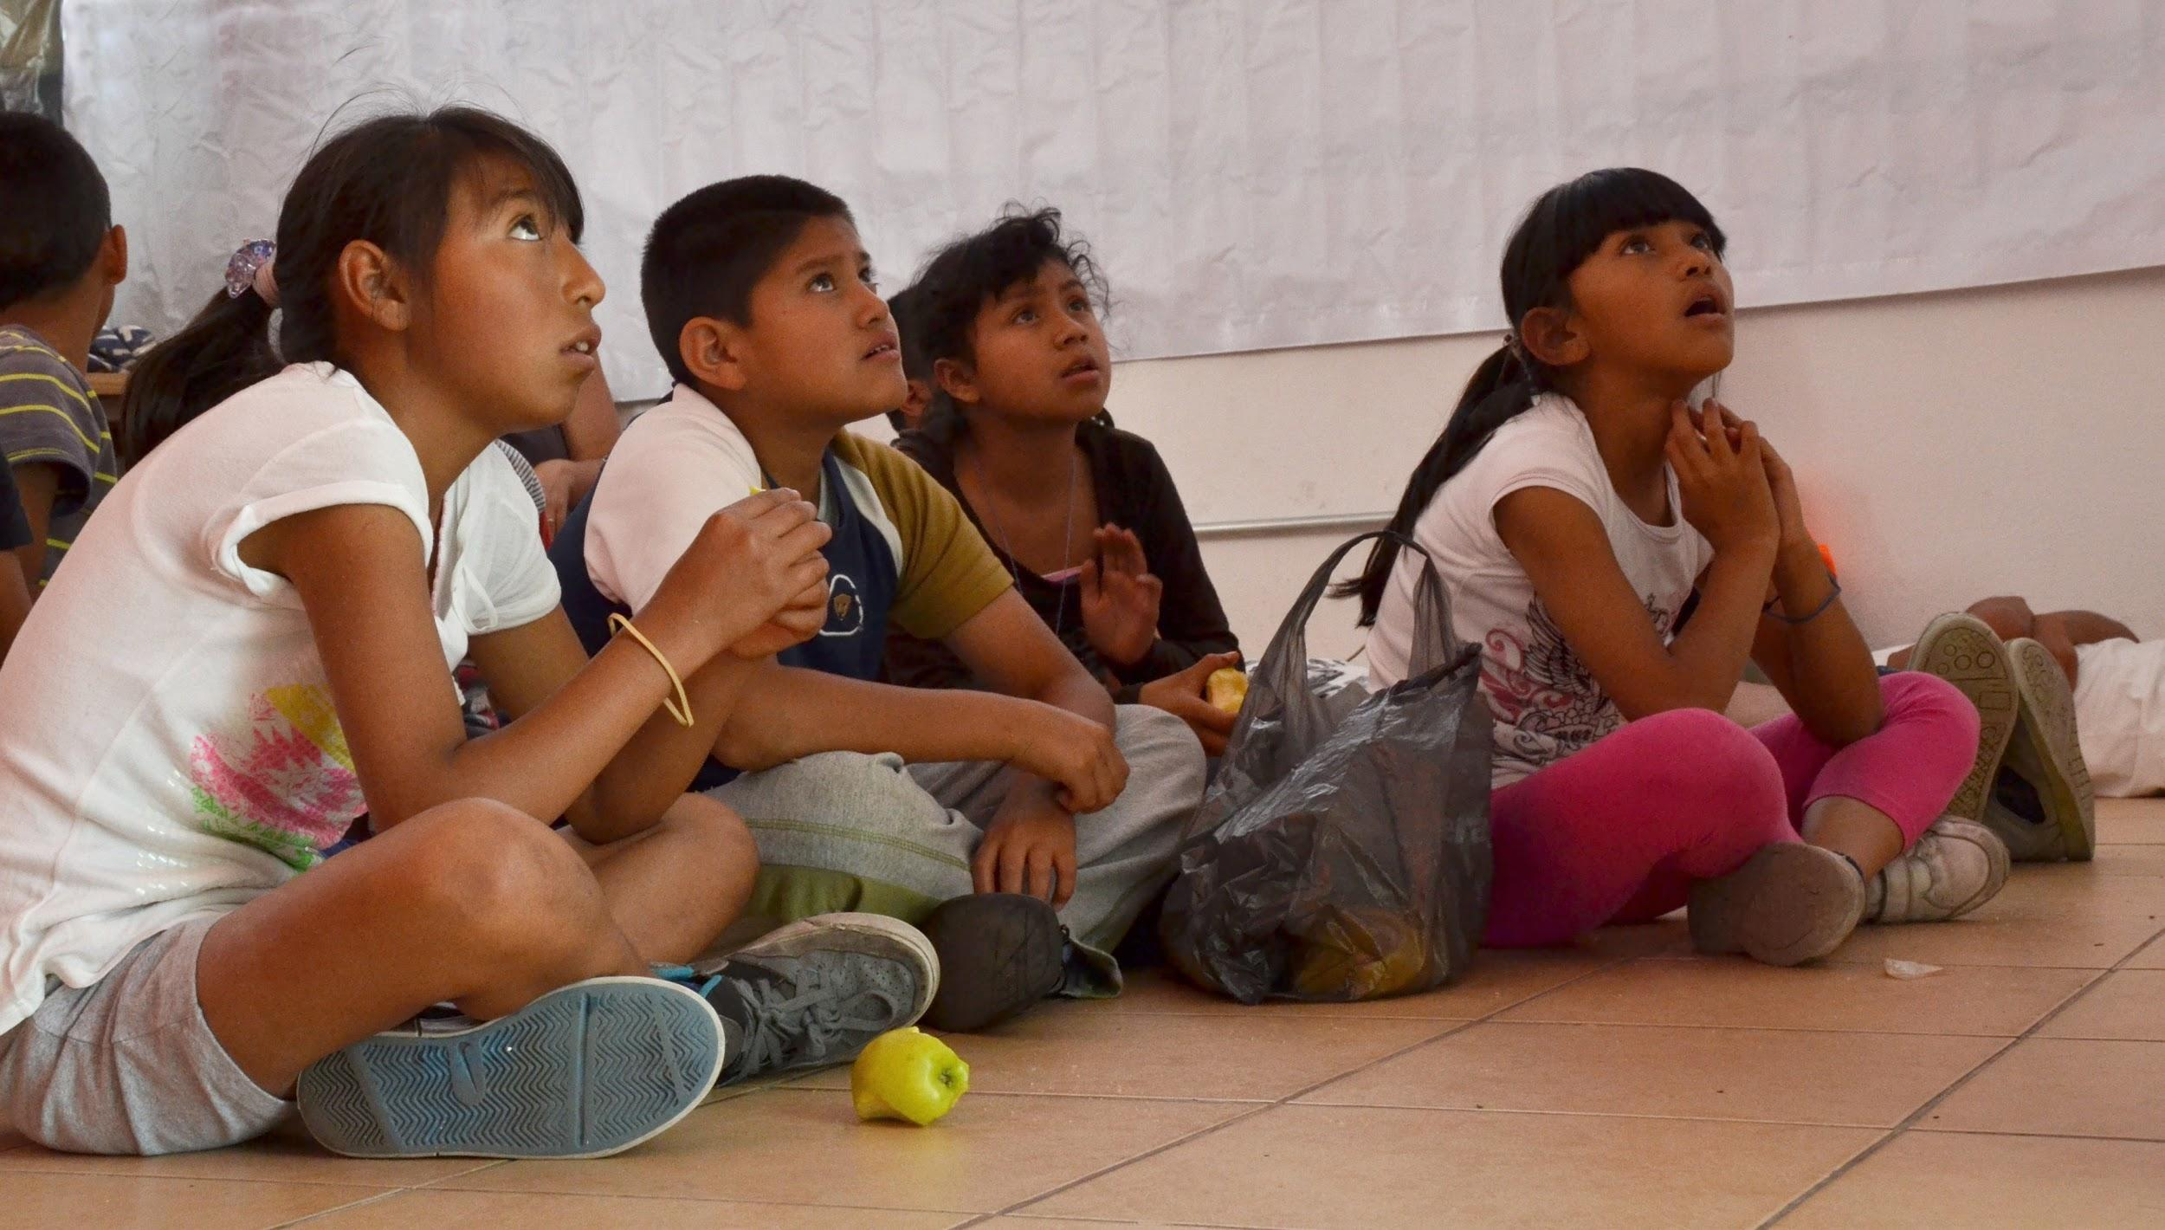
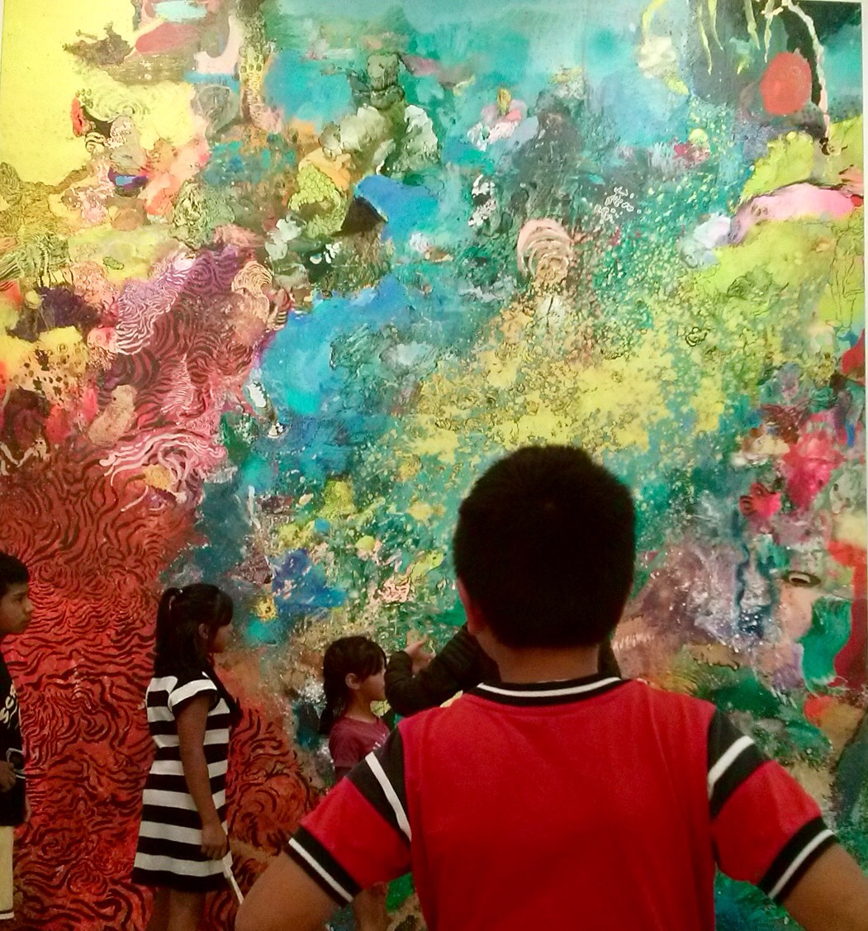
45m INTRODUCTION TO WORKSHOP
THEORY

Slide 14
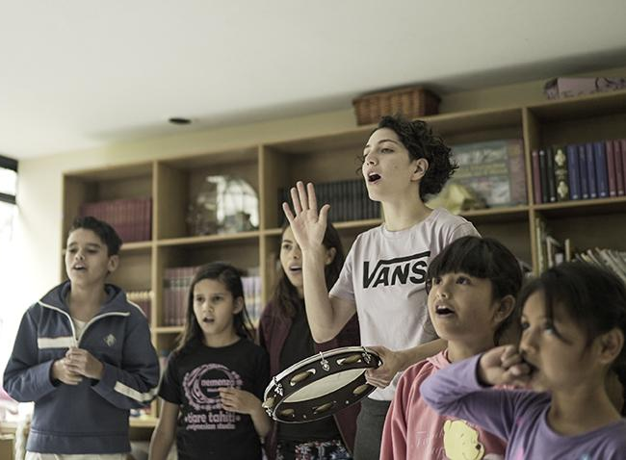
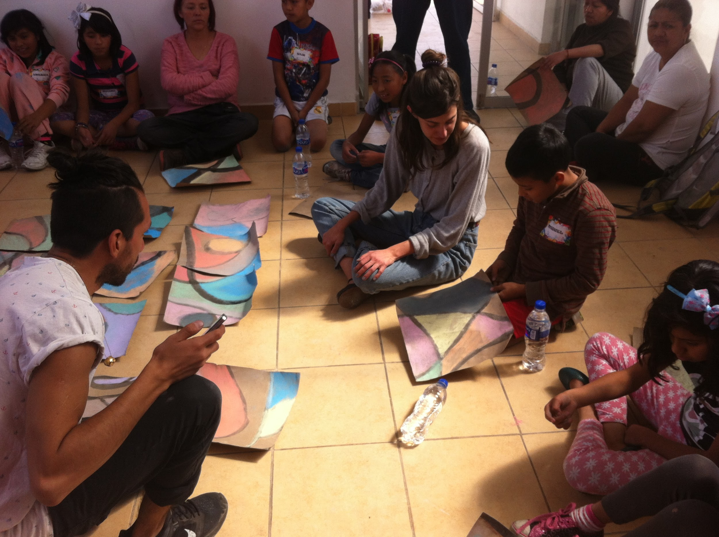
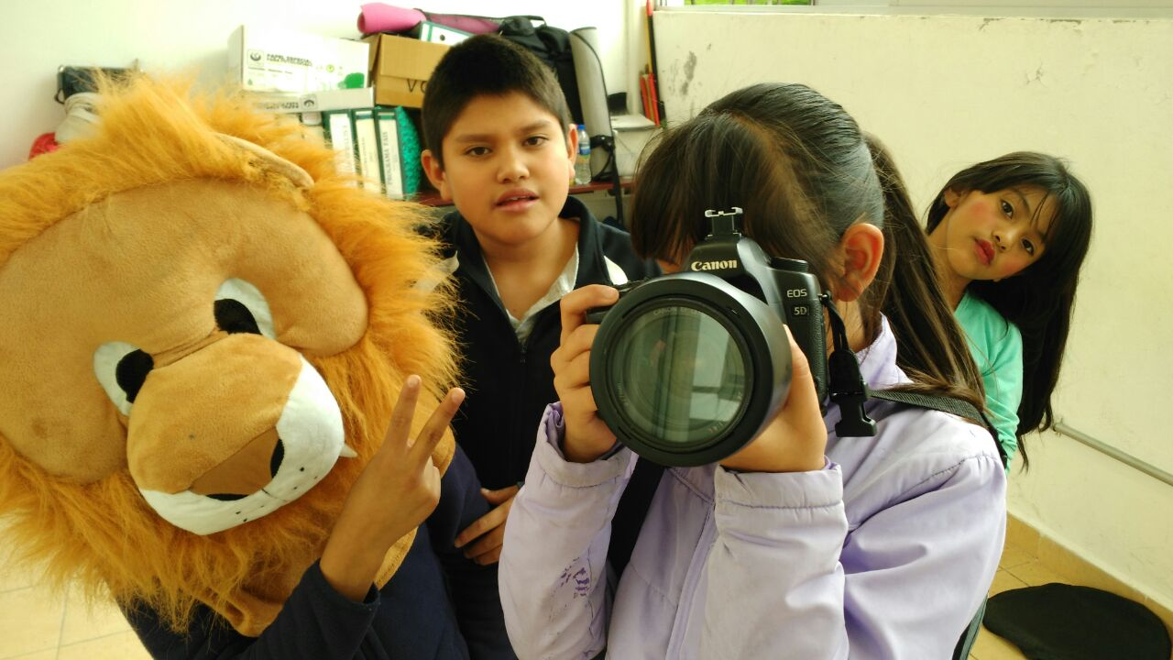
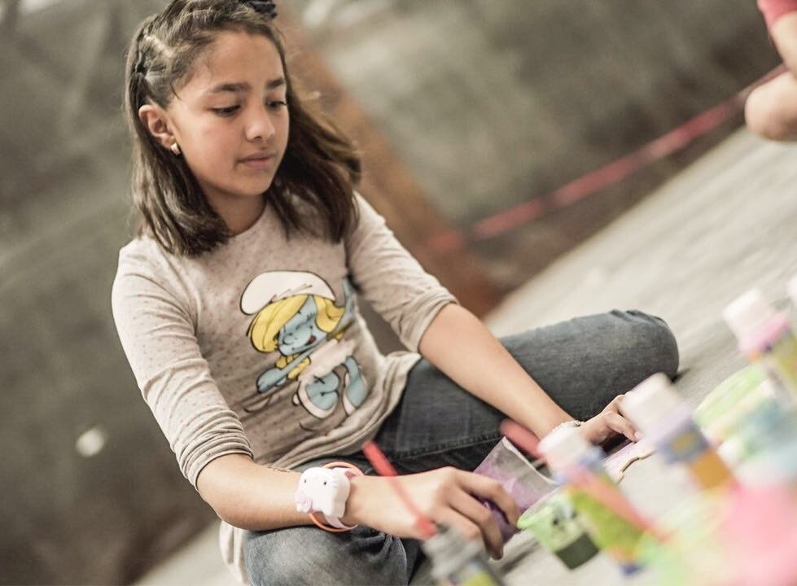
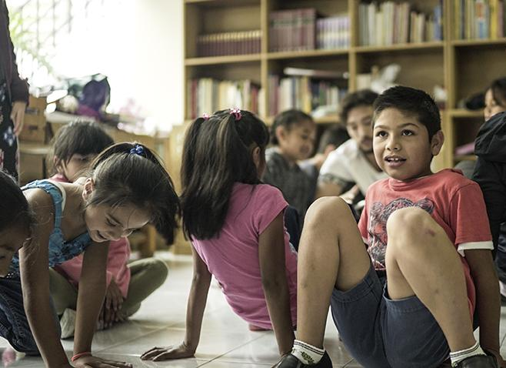
60m CREATIVE ACTIVITY

Slide 15
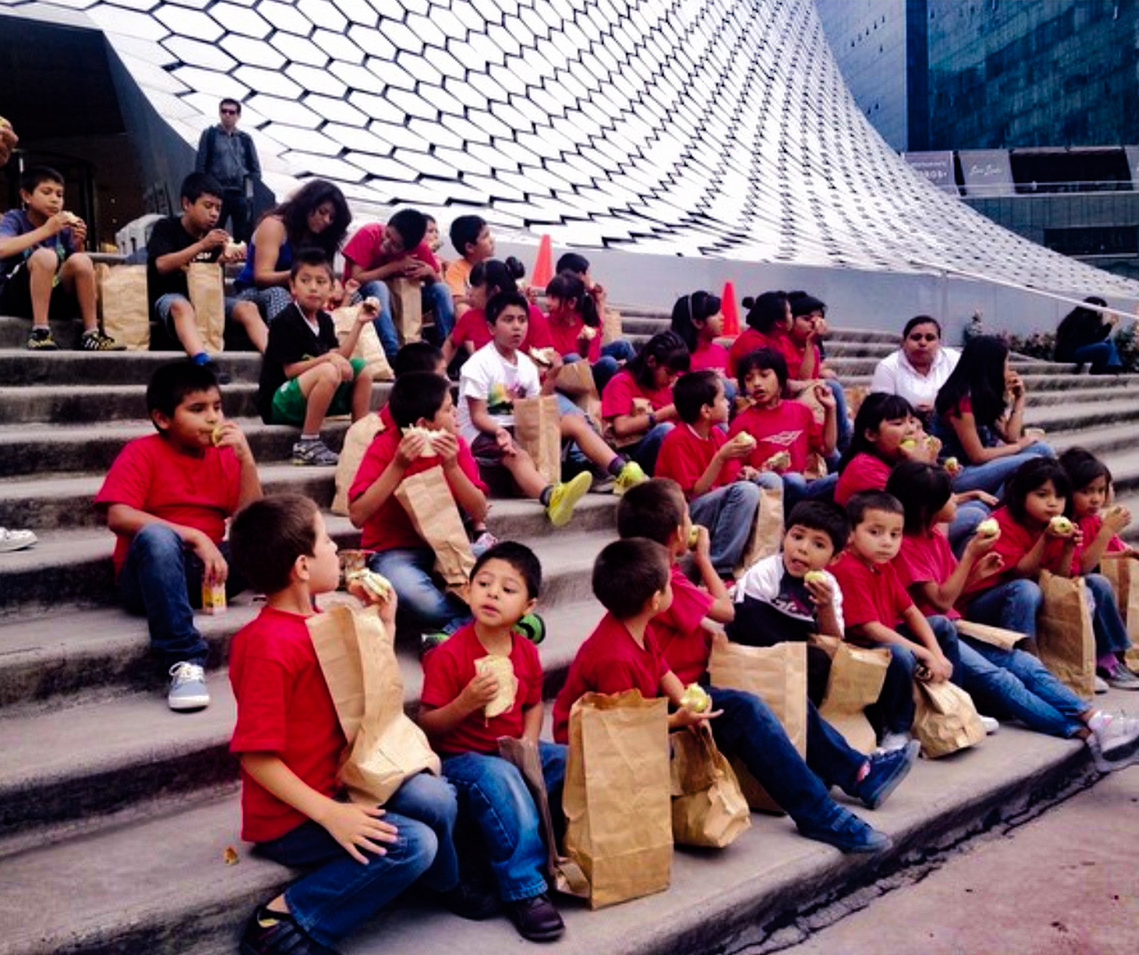
30m LUNCH

Slide 16
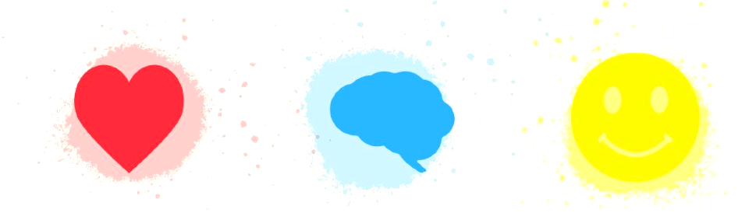
RESULTS
Focus on 3 Areas:
Emotional Cognitive Social
Health Skills Competences
° ARTE PRO IMPROVES POSSIBILITIES OF CONSCIOUSLY CHOOSING A DIFFERENT WAY OF LIFE THAN THE ONE LEARNT, AND BECOME A CHANGE AGENT FOR THEIR SURROUNDING

Slide 17
TESTIMONIALS

Slide 18
TESTIMONIAL
SILVIA, PEDAGOGUE IN SHELTER HOME FOR CHILDREN BORN IN PRISON
Our children didn’t communicate and were very aggressive.
As soon as the Arte Pro program starts, we start noticing changes, now they:
Are friendly and kind
Play with their classmates
Are capable of teamwork
Help each other out with homework
Express themselves through art
Are curious to learn more
Are definitely more self-confident
Their grades have improved considerably
Personally, I have always been fascinated by what they do in Arte Pro. The children have a beautiful time with real professionals, both artists and mental health professionals, who love their work. The best thing is, we not only collaborate from nonprofit to nonprofit, the core of our work are the children.

Slide 19
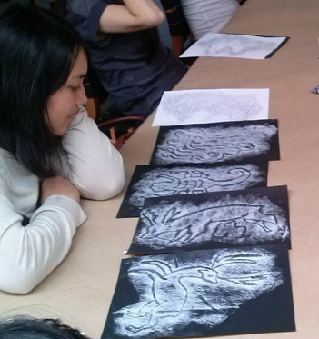
SUCCESSFUL CASE
LAURA, 16 YEAR OLD MOTHER
“I participated in several activities because I liked them, I am personally interested in art. They have helped me a lot in school and I learned new things. I didn't know ballet as such or had visited an artist’s studio.
My favourite activities were painting and learning more about the inspiration and the way of working of some artists. I think that culture is always helpful and part of a complete education. It is something everyone understands.
I thank Arte Pro for all the creations and my wish to pursue painting. As long as I can develop that and other forms of art, I think I can contribute to culture in México.”
* Laura is currently applying to study at the School of Bellas Artes in Mexico City with the help of Arte Pro’s Follow-Up Program
In the program since 2014

Slide 20
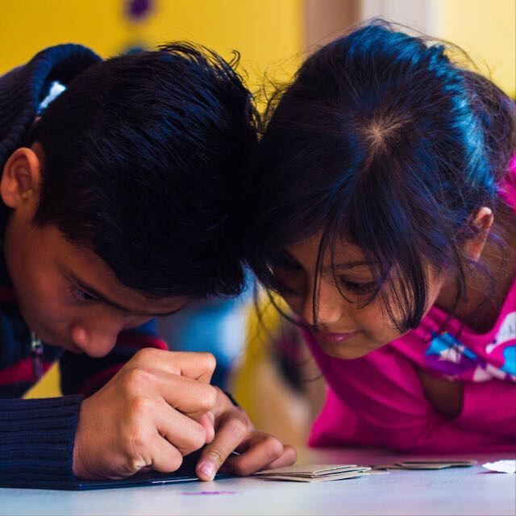
THANK YOU !
All the information on this presentation belongs to
artepro.mx
E Mail: arte@artepro.mx PayPal: arte@artepro.mx Facebook: @ArteProMx Instagram: @ArtePro

